Slide 1
The Great Depression Begins
The Nation’s Sick Economy
Hardship and Suffering During the Depression
Hoover Struggles With the Depression

Slide 2
Economic Troubles on the Horizon
As the 1920’s progressed, serious problems threatened the economic prosperity of the country.
Industries In Trouble
Railroads, textiles, and steel were barely making a profit
Many industries that prospered during the war were no longer necessary (i.e. mining, lumbering)
Decline in housing starts was an indicator that was ignored
Farmers Need A Lift
Agriculture suffered the most; farmers risked a lot to meet the demand that the war had created
After the war, crop prices fell 40%; the boost in production only made matters worse
McNary-Haugen Bill – legislation designed to help farmers with price supports for key products – buying a surplus of crops at guaranteed prices and selling them on the world market; bill was vetoed twice by President Coolidge.

Slide 3
Economic Troubles (cont.)
Consumers Have Less Money To Spend
By the 1920’s, Americans were buying less due to rising prices, stagnant wages, unbalanced distribution of income, and overbuying on credit.
Living On Credit
Buying goods on credit – an arrangement in which consumers agreed to buy now and pay later for purchases – often resulted in people living beyond their means.
The threat of debt caused many to cut back on spending.
Uneven Distribution of Income
The rich were getting richer and the poor were getting poorer; more than 70% of the nation’s families were earning less than $2500 per year
Electricity, heat, new clothing, and technological advances were just some of the things that people had to learn to live without

Slide 4
Hoover Takes Office
The Election of 1928
Herbert Hoover vs. Alfred E. Smith; Hoover had one major advantage in that he served as the Secretary of Commerce under Harding and Coolidge, and therefore could accredit the economic prosperity of their terms to his work.
Hoover won by an overwhelming majority.
Relying on the Stock Market
The stock market had become the most visible sign of economic prosperity, with the Dow Jones Industrial Average used as the barometer of the market’s health
Eager to take advantage of the “bull market”, many rushed to buy stocks and bonds; by 1929, 3 percent of the nation’s population owned stocks
PROBLEMS: speculation and buying on margin
Unrestricted buying of stock produced a false sense of security

Slide 5
The Stock Market Crashes
In early September of 1929, the market began to waiver; prices plummeted on October 24, 1929 – many tried to sell as much of their stock as possible…but the worst was yet to come.
Black Tuesday
October 29, 1929 – also known as Black Tuesday, this was the day that the value of stocks plummeted due to the massive push to sell stocks
The number of shares sold that day was a record 16.4 million…however there was additional millions that could not find buyers
This crash left many with huge debt, and wiped out the life savings of countless others
By mid-November had lost approximately $30 billion dollars…this crash would signal the beginning of the Great Depression

Slide 6
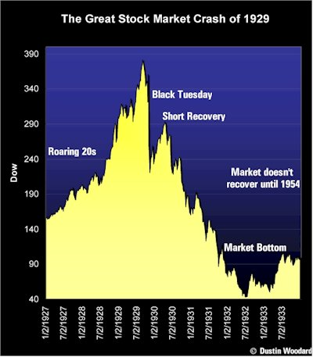
http://mutualfunds.about.com/cs/history/l/bl1929graph.htm

Slide 7
The Great Depression
The period between 1929 and 1941 would see the worst economic crises that the country has ever known
Bank and Business Failures
Those who tried to remove their money from banks found that many banks did not have the money to give due to investment in the market; 1933 – 11,000 of 25,000 banks in the country close
Approximately 90,000 businesses went bankrupt in the country by 1932; millions of workers lost their jobs, pushing unemployment to 25% by 1933
World-Wide Shock Waves
The depression made an already poor situation in Europe worse due to the fact that there was no trade going on between the States and foreign countries
Hawley-Smoot Tariff – 1930, this act passed by Congress was the highest protective tariff in US history, designed to protect farmers and manufacturers from foreign competition

Slide 8
Causes of the Great Depression
There are many factors that could be considered as contributing to the Great Depression, all of which are debatable. However, there are 4 main causes that seemingly worked together to cause the crash, and ultimately the Depression:
Tariffs and war debt policies that cut down the foreign market for American goods
A crises in the farm sector
The availability of easy credit
An unequal distribution of income
Despite all of this, President Hoover was encouraging citizens to remain confident about the economy in November of 1929.

Slide 9
People Affected by the Depression: Chapter 14: Section 2
Both
Family became the source of strength
Men had difficulty coping – becoming hoboes – abandoned family, wandering
Women worked to keep families together by canning, sewing: many starved to death due to shame
Children were exposed to disease; desperation led to traveling the country
Suicide rates high, Psychological problems, doctors sacrificed, etc.
Farmers
Similar to city, but could grow food for families
Lost land due to falling prices, rising debt
Foreclosures
Tenent farming to try to scratch a living
Overproduction of land = Dust Bowl
gghj
City Dwellers
Lost jobs
Evicted from homes
Sleeping in parks, sewer pipes
Shanty towns = Hoovervilles
Bread lines
Soup kitchens
Many would sleep in rusted out cars, etc.

Slide 10
Hoover’s Actions to Combat Depression
Urge business, banking, labor leaders not to cut wages or lay off workers
2. Boulder (Hoover) Dam
Federal Farm Board
Federal Home Loan Bank Act
Reconstruction Finance Corporation
Cautious approach would help prevent making matters worse; economy was still shrinking
→Gain $ from the sale of electricity produced; provide electricity and water to nearby cities for agriculture; success
Raise crop prices by helping members buy crops/keep off market until prices rose
Lowered mortgage rates and allowed farmers to refinance and avoid foreclosure
Authorized $2 billion emergency financing for banks, life insurance co., railroads, other large businesses.

